Slide 1


Test Automation Using Selenium
Fair Hike Academy
That’s the way the cookie crumbles!
Session 2: Test Automation Frameworks
Mentor : Naresh Vulli, CSTE, PAHM.
fairhike@gmail.com www.fairhike.blogspot.com | www.facebook.com/fairhike

Slide 2
Today’s Topics
Recap
QTP vs Selenium – a brief comparison
Automation Framework
Data Driven Framework
Keyword Driven Framework
Hybrid Framework
Shared/Common Library Framework
Page Object Model Framework
Takeaway or Exercise

Slide 3
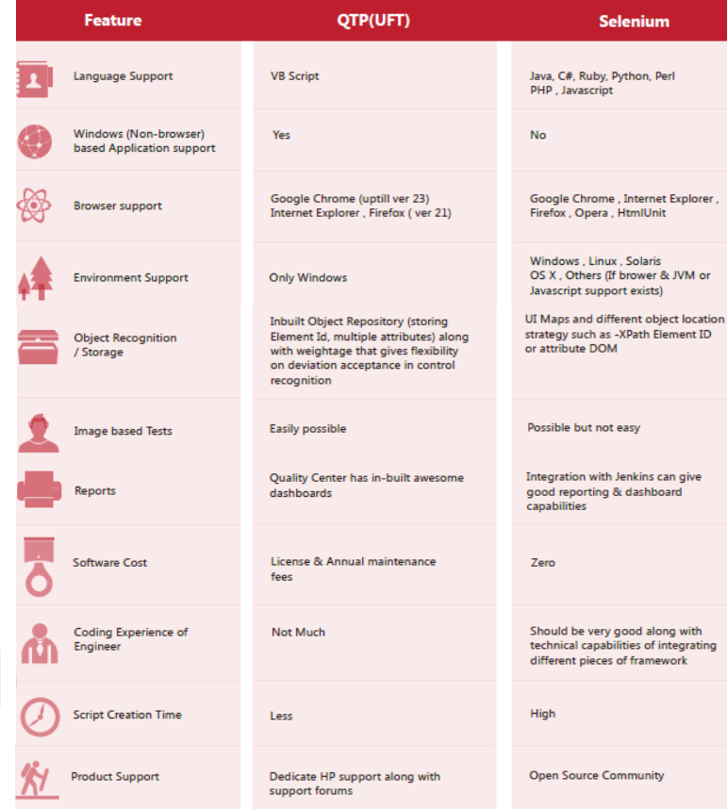
QTP vs Selenium – a brief comparison

Slide 4
Automation Framework
Automation framework is a combination of functions libraries, Utilities and how they interrelate; Well organized structural representation of the same; Set of guidelines that enable faster development;
Automation framework is generally more comprehensive than a procedure and more strict than a structure.

Slide 5
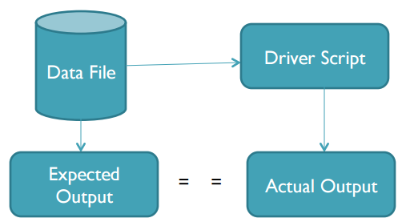
Data Driven Framework
Test input and Expected output values are read from data files (ODBC sources, CSV files, Excel files etc.)
Automation script acts as a "driver," or delivery mechanism, for the data
Notes:
Fast : Automation tool runs tests significantly more faster than human users
Reliable : Automation tool can perform the same operation each time, if you repeat multiple times, so that we can eliminate human errors
Repeatable : We can check how application or website reacts after repeating the same operation multiple times
Reusable : Automation scripts are reusable on different version of the application of websites even if the user interfaces changes
Comprehensive : In automation testing we can build a suit of tests that covers every feature in the application or website
Programmable : We can program sophisticated Tests that bring out hidden information from the application

Slide 6
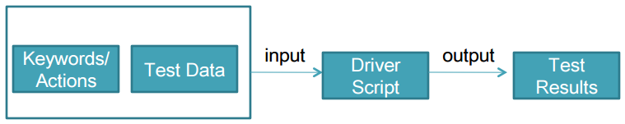
Keyword Driven Framework
Along with test data, the directives telling what to do which is in the test scripts also are put in external input data file.
Automation expertise is not required to maintain or create a new set of test cases.

Slide 7
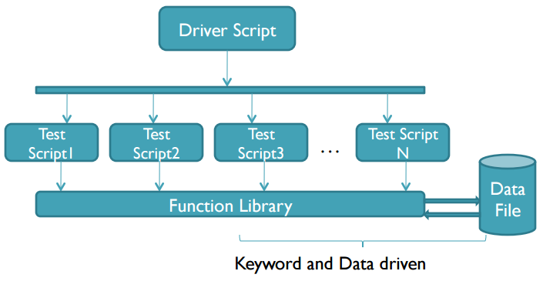
Hybrid Framework
Combination of all best possible techniques, pulling from their strengths and trying to mitigate their weaknesses

Slide 8
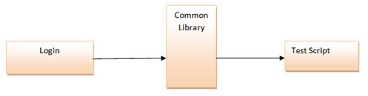
Shared/Common Library Framework
We segregate the application into methods or common functions can be used by the other parts of the application as well. we create a common shared library constituting of common functions for the application under test.
These libraries can be reused within the test scripts whenever required

Slide 9
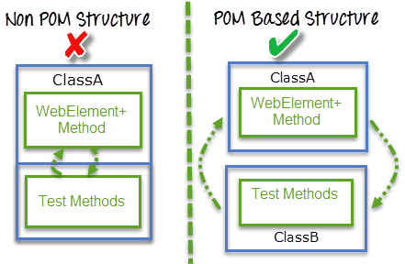
Page Object Model Framework
Page object model gives more focus on how the code is being structured to get the best benefit out of it.
All object elements and methods which can be performed on that object on the webpage get stored in one class file.

Slide 10
Takeaway or Exercise
Get Detail understanding on Automation Frameworks
Explore more Automation Frameworks

Slide 11
Q & A

Slide 12
Thank You ☺

